Slide 1

iM8 Blockchain Architecture
September 2020

Slide 2
Confidentiality Statement
The reader of this document hereby acknowledges that the information provided is completely confidential and therefore the reader agrees not to disclose information from this document without the express written consent of iM8 Data Limited It is also acknowledged by the reader that the information to be furnished in this document is in all aspects confidential in nature, other than information that is in the public domain through other means, and that any disclosure or use of the same by the reader may cause serious harm and or damage to iM8 Data Limited Upon request this document will be immediately returned to iM8 Data Limited
All information contained in this document is © iM8 Data Limited

Slide 3

At iM8 we transform the traditional QR code into an individualised dynamic digital tag
We give each product its own unique fingerprint

Slide 4

Blockchain Guaranteed Traceability

Slide 5
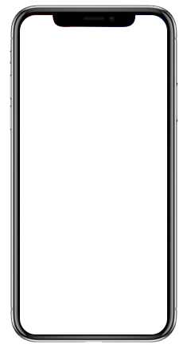
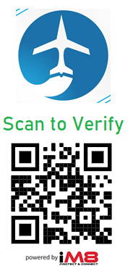
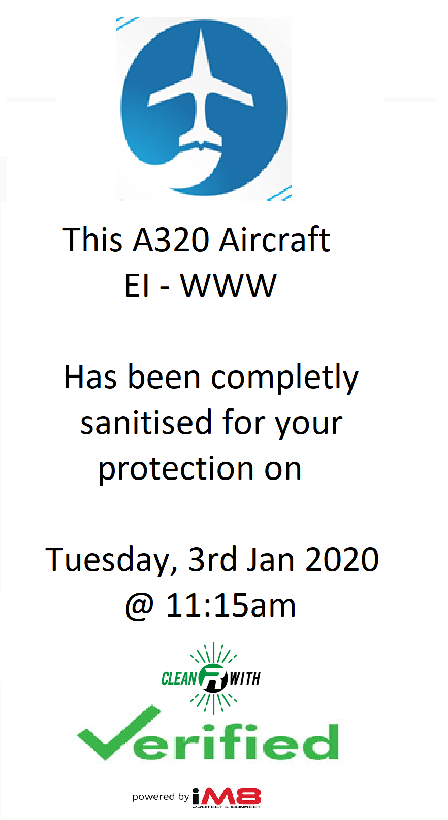
Blockchain Verified Usage Transparency
Scan
The user uses their phone to scan the Blockchain secured QR area code to receive instant verification as to when the area has been sanitised

Slide 6
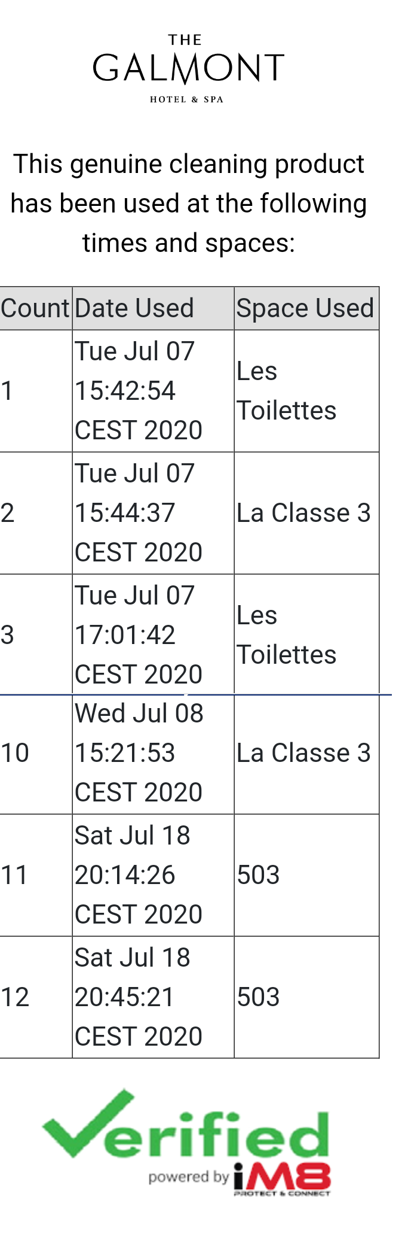
Product Usage Tracking
iM8 tracks and records every time a multi use surface cleaner is used

Slide 7
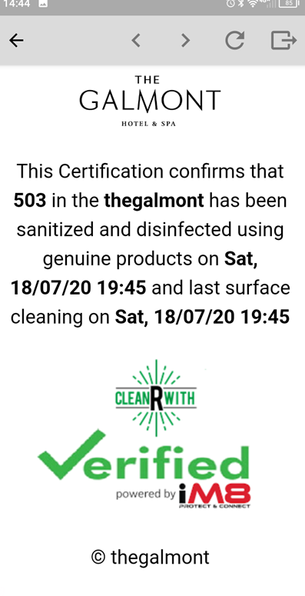
Product Usage Tracking
iM8 tracks and records every time an atmospheric sanitiser is used, either on its own or in conjunction with a multi use surface cleaner

Slide 8

The iM8 Blockchain
The iM8 Blockchain utilises the IBM Hyperledger Fabric Blockchain Ledger Architecture
This architecture is an open source platform created by IBM to encourage the use of Blockchain solution in businesses and to develop Blockchain technology for wider industry

Slide 9
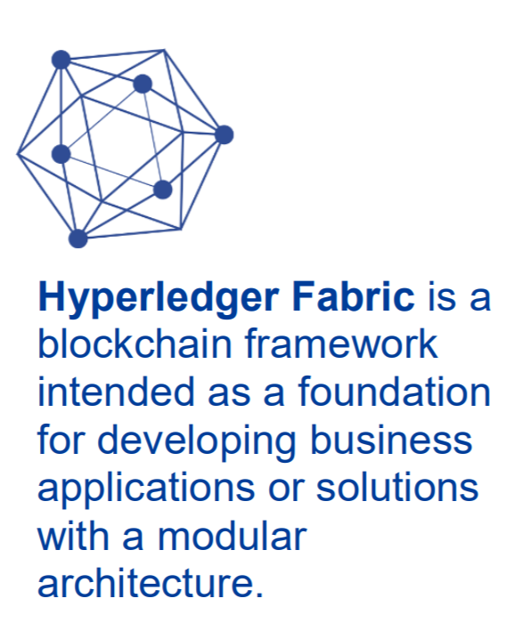
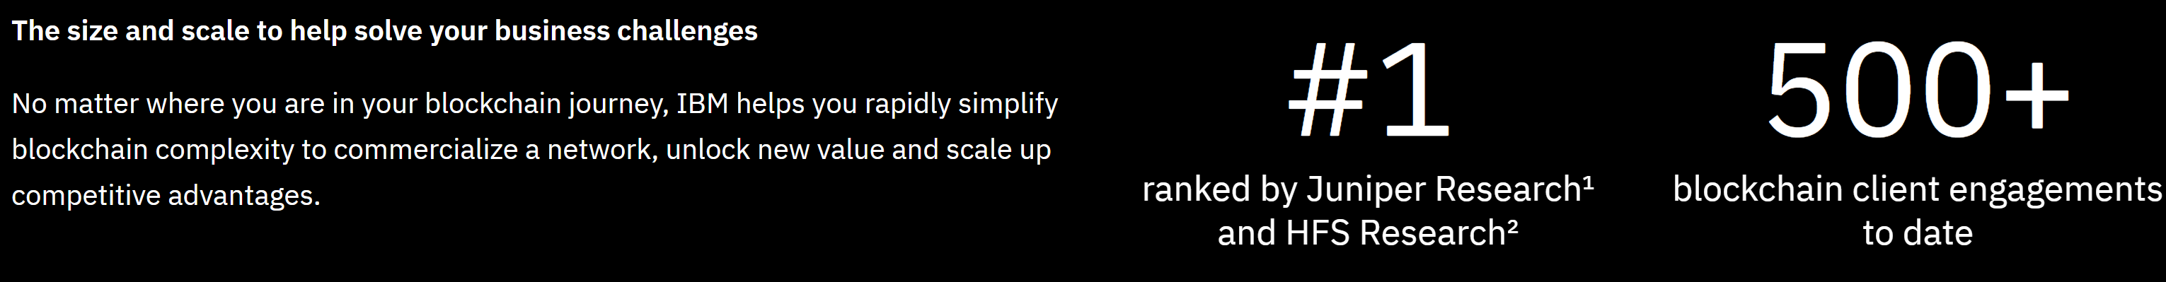
The iM8 Blockchain
Fraud avoidance. The distributed and tamper-resistant nature of blockchain platforms could reduce the likelihood of fraud that may be inherent to specific industries. The value this benefit provides could be quantified by evaluating fraud risk exposure and calculating the resultant risk reduction that could be realized from implementing a blockchain-based solution.
Inventory loss avoidance. Blockchain platforms could improve efficiency and provide clarity and insight into the overall supply chain. This benefit could be quantified by identifying the efficiencies and savings that blockchain delivers to your organization. For example, moving to blockchain-based supply management can reduce food spoilage by shortening the time to get through the supply chain, or by identifying the specific food shipments that may be spoiled or otherwise contaminated during a recall.

Slide 10
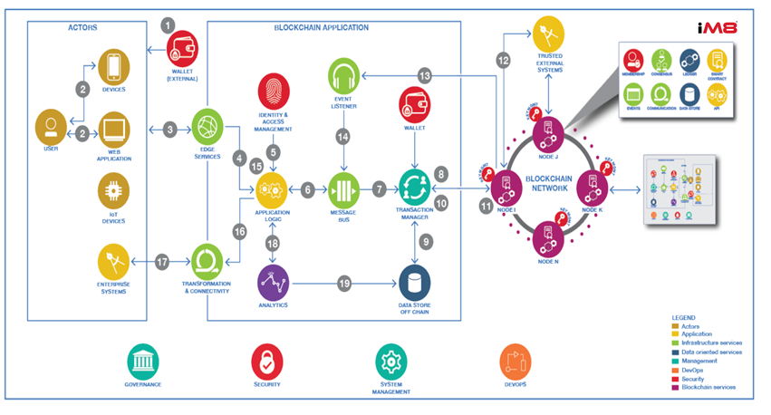
iM8 Blockchain Reference Architecture

Slide 11
What does a Blockchain transaction look like?
Successfully enrolled user "admin" and imported it into the wallet
Successfully enrolled user "appUser" and imported it into the wallet
{"name":"Zain","description":"this is a test customer"}
{"owner":"NoOwner","name":"blue shirt","description":"this is a test","category":"Clothes","status":"Available"}
{"owner":"Cust0","name":"BlueShirt","description":"test","category":"Clothes","status":"Sold"}
Tests run: 1, Failures: 0, Errors: 0, Skipped: 0, Time elapsed: 0.0181 sec
(Transaction log from iM8 Blockchain – 27/07/20)

Slide 12


